Slide 1
Drone Recognition Capture
PRESENTED BY TEAM4
SHIZUN WANG
XINYUE HAO
HASEEM
JONA
MOHAMMED ALMUHAIRI

Slide 2
CONTENT
01 INTRODUCTION
02 DATAFLOW
03 TEAMWORK

Slide 3
Part One
INTRODUCTION

Slide 4
Part Two
DATAFLOW

Slide 5
02
PART TWO
DATAFLOW
Drone Camera
RTMP Server (Laptop)
OpenCV (Laptop)
Transmits a video stream using the RTMP protocol
Receives the camera feed live and transmits it to others in the network.
Analyses the video feed to recognize the trained individual and takes a picture ☺

Slide 6
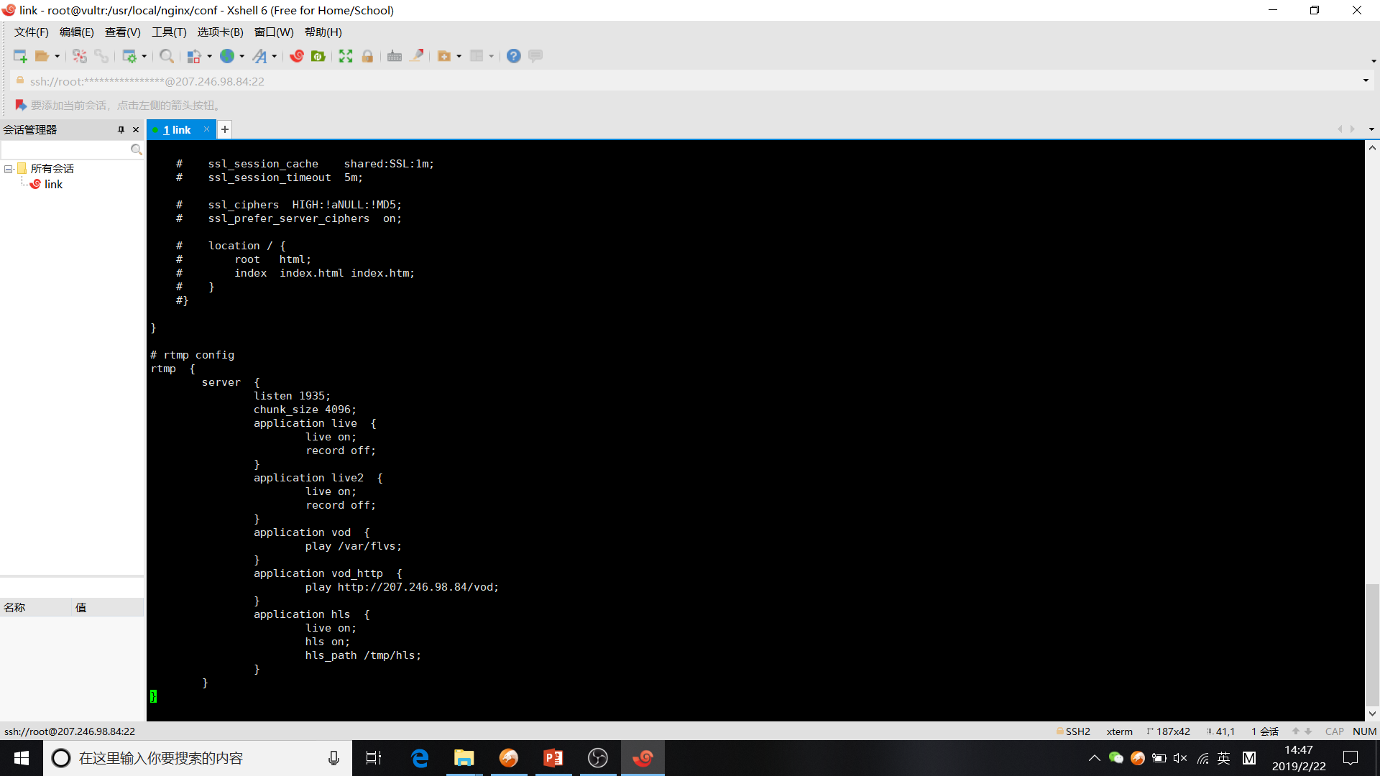

Slide 7
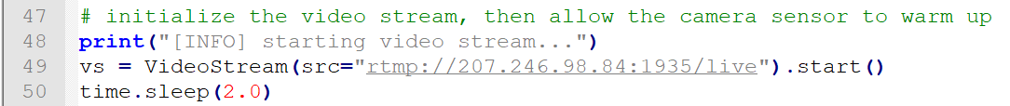
02
PART TWO
DATAFLOW
Extract embeddings from face dataset
Train face recognition model
Recognize faces in video streams

Slide 8
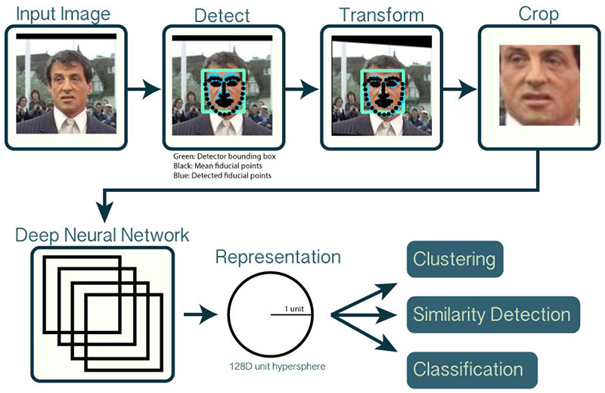
02
PART TWO
DATAFLOW

Slide 9
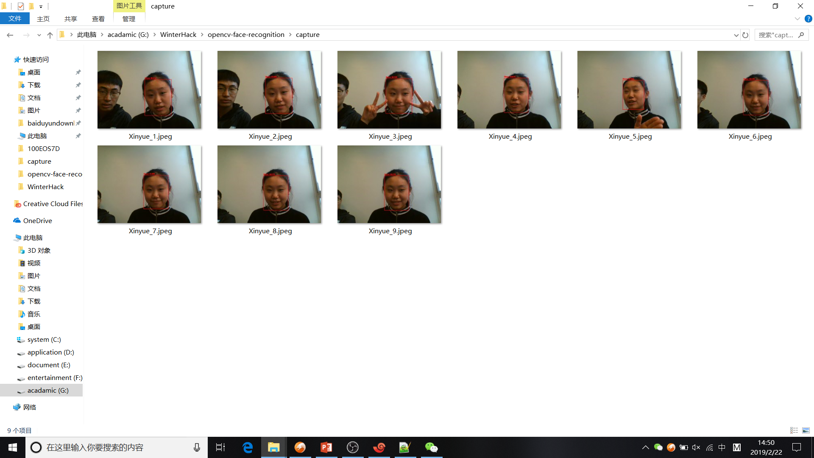

Slide 10
Part Three
TEAMWORK

Slide 11
03
PART THREE
TEAMWORK
SHIZUN WANG
JONA
HASEEM
XINYUE HAO

Slide 12
WHERE DO WE GO FROM HERE?

Slide 13
THANK YOU
FROM TEAM 4
☺

